Slide 1
Why software engineering?
Acquire skills to develop large programs
Systematic techniques study

Slide 2
Syllabus-unit-I
Overview: Introduction:
Professional Software Development, Software Engineering Ethics, Case studies.
Software Processes: Models, Process activities, Coping with Change, Process improvement.
Requirements Engineering and System Modeling:
Software Requirements: Functional and Non-functional requirements. Requirements Elicitation, Specification, Validation and Change

Slide 3
Unit-II
System Modeling: Context models, Interaction models, Structural models, Behavioural models, Model driven
architecture. Architectural Design: Design decisions, Architectural views, Architectural patterns and
architectures Design and implementation: Object oriented design using UML, Design patterns, Implementation
issues, Open-source development

Slide 4
Unit-III
Software Testing: Development testing, Test-driven development, Release testing, User testing.
Software Evolution: Evolution processes. Legacy system evolution, Software maintenance
Component based software engineering: Components and component models, CBSE processes, component composition

Slide 5
Unit-IV
Project Management: Risk Management, Managing People, Teamwork, Project Planning: Software Pricing,
Plan driven development, Project Scheduling, Agile planning, Estimation Techniques, COCOMO cost modeling

Slide 6
Unit-V
Agile Software Development: Introduction to agile methods, Agile development techniques, Agile project management and scaling agile methods.
Kanban, Flow, and Constantly Improving:
The Principles of Kanban, Improving Your Process with Kanban, Measure and Manage Flow , Emergent Behavior with Kanban
The Agile Coach : Coaches Understand Why People Don‟t Always Want to Change , Coaches Understand How People Learn , Coaches Understand What Makes a Methodology Work , The Principles of Coaching

Slide 7
Text Books
Ian Sommerville,“ Software Engineering”, 9th Edition, Pearson Education, 2013, ISBN: 9788131762165
Roger.S.Pressman,“ Software Engineering-A Practitioners Approach”, 7th Edition, Tata McGraw Hill, 2007, ISBN: 9780071267823
Pankaj Jalote,“ An Integrated Approach to Software Engineering”, 3rd Edition, Narosa Publishing House, 2013, ISBN:9788173197024
Rajib Mall, Fundamentals of Software Engineering, 3rd Edition, Prentice-hall Of India Pvt Ltd., 2012, ISBN: 9788120348981.

Slide 8
Course Outcomes
Co1: Comprehend various software life cycle models and steps of software development process.
Co2: Apply concepts of Software Project Planning and software Design techniques
Co3:Analyze capabilities of various tools to assist in the software development activities
Co4: Develop robust software design and software project plan from requirement gathering to implementation

Slide 9
UNIT-I-Chapter 1,2,3
Professional software development
Software engineering ethics
Case studies

Slide 10
Objectives
understand what software engineering is and why it is important;
understand that the development of different types of software systems may require different software engineering techniques;
understand some ethical and professional issues that are important for software engineers;

Slide 11
Software Engineering
Deals with cost effective Software Development
Systematic collection of past experience resulted in techniques, methodologies, guidelines for software development

Slide 12
Case studies
Embedded system: software controls hardware, issues include: physical size, responsiveness, power management.
Information system: managing access to a database of information. Issues include: security, usability, privacy, maintaining data integrity.
Sensor-based data collection system: requirements: reliability, maintainability. Ex: wilderness weather station.

Slide 13
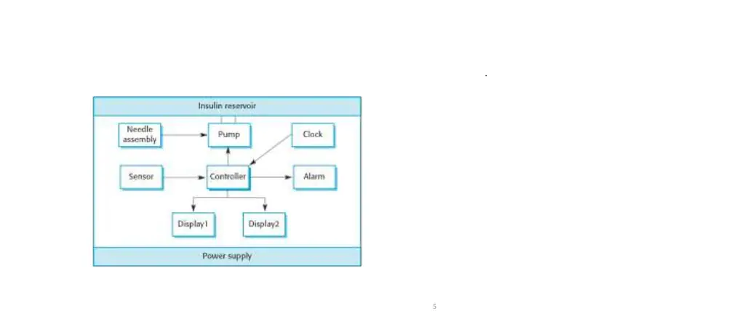
Insulin pump control system

Slide 14
The wilderness weather system
Case study

Slide 15
Weather information
A national weather service wishes to collect weather information from remote areas to help with weather forecasting, forecast accuracy assessment and climate change modeling.
Currently, limited collections are made manually by people visiting remote stations every day.
This is expensive and time consuming
Some areas have no coverage because of difficulties of access (no road, heavy snowfall, etc.)
The intention therefore is to develop remote automatic collection systems that are connected to a broader weather information system.

Slide 16
Overall system organization
WS1
WS2
WS3
WS..
WSn
Weather information system
Satellite information
Weather radar information
Weather data archive

Slide 17
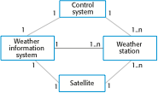
System context for the weather station

Slide 18
Weather station characteristics
Must be self-contained and completely autonomous
Integral power supplies and power generation
Satellite communications
Ruggedized to tolerate extreme weather
Self-testing
May exist in several version for different types of deployment
Highland areas based on wind power
Desert areas based on solar power
Remote control to support autonomous operation
Dynamic software re-configuration

Slide 19
Essential system functionality
Collect weather information from instruments at regular intervals
Transmit this information, on request, to the weather information system over the satellite link
Store information if communications are not available
Monitor external conditions and shut down power generation/instruments if threat of damage from extreme weather
Run regular diagnostic tests to assess overall health of system

Slide 20
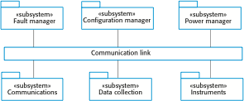
Software architecture

Slide 21
System software
Embedded software but not real-time in the sense that rapid reaction to events is required.
Developed using an object-oriented approach
OO approach associates objects with the physical entities in the system e.g.
Weather data collection instruments
Power supply and generation
Communications
Data may be stored as objects
No requirement for large-scale database

Slide 22
Engineering approach of developing software:
Past experience is used
Systematically arranged
Quantitative techniques provided
Few thumb rules
Pragmatic approach for cost effectiveness

Slide 23
Software Products
Generic products
Customized products

Slide 24
Software Products
Generic products : standalone systems that are manufactured and marketed, sold to any customer who wants to use them
Ex: graphics programs, appointment booking software, project management tools, CAD software.
Customized products: software made to a specific customer to meet their own needs.
Ex: air traffic control software, traffic control software, banking software.

Slide 25
Software Products
Specifications of software, changes decisions are made by developer in case of generic software
Specifications , changes decision are made by customer who owns the software.

Slide 26
FAQs about software engineering
What is software
What are the attributes of good software
What is software engineering
What are the fundamental software engineering activities
What is the difference between software engineering and computer science
What is the difference between software engineering and system engineering

Slide 27
FAQs about software engineering
Key challenges facing software engineering
Costs of software engineering
Best software engineering techniques and methods

Slide 28
Attributes of a good software
Maintainability:support evolution.
Dependability and security: reliable, safety,security.
Efficiency: utilization of resources,responsiveness, processing time.
Acceptability:refers to users acceptance

Slide 29
Software process activities
Software specification
Software development
Software validation
Software evolution

Slide 30
Types of application in determining SE methods
Stand-alone : voice controlled assistance, security cameras
Interactive transaction-based applications
Embedded control systems
Batch processing systems: payroll, subscription cycles, billing , report generation
Entertainment systems
System for modelling and simulation:traffic systems, flexible manufacturing systems
Data collection system: surveys, interviews, tests,

Slide 31
General issues that affect software
Heterogeneity : operation across different types of systems and devices.
Business and social change: develop new systems rapidly
Security and trust
Scale

Slide 32
Software engineering ethics
Confidentiality:Engineers should normally respect the confidentiality of their employers or clients irrespective of whether or not a formal confidentiality agreement has been signed.
Competence: Engineers should not misrepresent their level of competence. They should not knowingly accept work which is out with their competence
Intellectual property rights:Engineers should be aware of local laws governing the use of intellectual property such as patents, copyright, etc. They should be careful to ensure that the intellectual property of employers and clients is protected

Slide 33
Software engineering ethics
Computer misuse:Software engineers should not use their technical skills to misuse other people’s computers.

Slide 34
Case studies
A personal insulin pump
A mental health case patient management system
A wilderness weather station

Slide 35
Software Processes
understand the concepts of software processes and software process models;
introduced to three generic software process models and when they might be used
know about the fundamental process activities of software requirements engineering, software development, testing, and evolution;
understand why processes should be organized to cope with changes in the software requirements and design;
understand how the Rational Unified Process integrates good software engineering practice to create adaptable software processes.

Slide 36
Topics
Software process models
Process activities
Coping with change
Process improvement

Slide 37
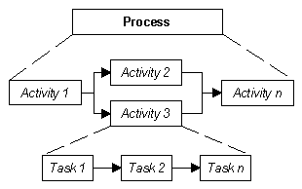
Basic Definition
Task: basic unit of work, well defined, assigned to one person
Activity: group of related task in software development, each activity has input and output
Process: set of related activities that leads to final software.

Slide 38
Software process activities
Specification – defining what the system should do;
Design and implementation – defining the organization of the system and implementing the system;
Validation – checking that it does what the customer wants;
Evolution – changing the system in response to changing customer needs
A software process model is an abstract representation of a process. It presents a description of a process from some particular perspective.

Slide 39
Process descriptions may also include:
Products, which are the outcomes of a process activity;
Roles, which reflect the responsibilities of the people involved in the process;
Pre- and post-conditions, which are statements that are true before and after a process activity has been enacted or a product produced.

Slide 40
Plan-driven and agile processes
Plan-driven processes are processes where all of the process activities are planned in advance and progress is measured against this plan.
In agile processes, planning is incremental and it is easier to change the process to reflect changing customer requirements.
In practice, most practical processes include elements of both plan-driven and agile approaches.
There are no right or wrong software processes

Slide 41
Difference between plan driven and agile
Plan driven | Agile
Larger teams | Smaller teams
Refactoring inexpensive | Refactoring expensive
Suitable for large systems | Suitable for small to medium sized systems
Suitable for stable development environment | Suitable for dynamic development environment
Requires experienced personnel at the beginning | Requires experience through out the process

Slide 42
Software process models
The waterfall model
Incremental development
Reuse oriented Software Engineering

Slide 43
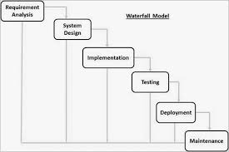
Water fall model

Slide 44
Water fall model
There are separate identified phases in the waterfall model:
Requirements analysis and definition
System and software design
Implementation and unit testing
Integration and system testing
Operation and maintenance

Slide 45
Water fall model
The main drawback of the waterfall model is the difficulty of accommodating change after the process is underway.
Inflexible partitioning of the project into distinct stages makes it difficult to respond to changing customer requirements
The waterfall model is mostly used for large systems engineering projects where a system is developed at several sites

Slide 46
Water fall model-example-Banking Application
Requirements are gathered by the business analyst and they are analyzed by the team. Requirements are documented during this phase and clarifications sought.
The Business Analysts document the requirement based on their discussion with the customer.
Will the new banking application be used in more than one country?
Do we have to support multiple languages?
How many users are expected to use the application? etc

Slide 47
Water fall model-example-Banking Application
The architect and senior members of the team work on the software architecture, high level and low-level design for the project.
It is decided that the banking application needs to have redundant backup and failover capabilities such that system is accessible at all times.

Slide 48
Water fall model-example-Banking Application
The development team works on coding the project.
Security checks will be implemented
Reviews, static analysis will be done

Slide 49
Water fall model-example-Banking Application
The testing team tests the complete application and identifies any defects in the application.
Some of the high level activities of deployment include installing the OS on the servers, installing security patches, hardening the servers, installing web servers and application servers, installing the database etc.

Slide 50
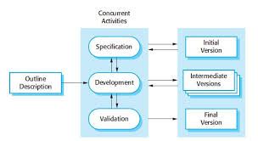
Incremental development

Slide 51
Incremental development
Incremental development is based on the idea of developing an initial implementation, exposing this to user comment and evolving it through several versions until an adequate system has been developed

Slide 52
Example of incremental development
Suppose we want to develop a web-based social network with the following functionalities;
The user should signup for the system.
The user should log into the system and can send or accept the friend request.
Convert this system into separate components;

Slide 53
Example of incremental development
Component 1: Sign up and log in
Component 2: Send Friend request
Component 3: Accept friend request

Slide 54
Incremental development benefits
The cost of accommodating changing customer requirements is reduced.
It is easier to get customer feedback on the development work that has been done.
More rapid delivery and deployment of useful software to the customer is possible.

Slide 55
Incremental development problems
The process is not visible
System structure tends to degrade as new increments are added

Slide 56
Incremental and Iterative development
Suppose to add a new login functionality to a website, and is decided to develop this using agile methodology, working in two-week delivery cycles (iterations).

Slide 57
Incremental and Iterative development
First iteration:
The minimum working version of the login functionality worth delivering to users would be
Create a web page where the users will see the login form
Add a login form with just two fields (username and password) and a login button, i.e. just a normal HTML form with no styling or validation.
Create a “welcome” page so when a users log in, they will see a message.
This basic login feature went through design, development, and testing and delivered at the end of the iteration.

Slide 58
Incremental and Iterative development
Second iteration:
In next iteration, we want to enhance the login functionality of what was built in the last iteration. We may decide to do
Build validation rules around input parameters
Add some CSS so the login form looks pretty
Display a message when user tries to login with invalid credentials
Now new functionality is added and enhanced existing functionality. In other words, we have incremented the existing login functionality, in this iteration.

Slide 59
Incremental and Iterative development
Third iteration:
In iteration three, we can yet again increment our login functionality, by adding
Forgotten password functionality
“Remember me” checkbox
Redirection mechanism to redirect to appropriate pages when users log in.
in each iteration, the login functionality is incremented by adding new useful features for the users.

Slide 60
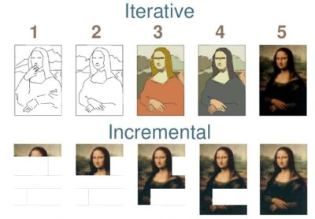

Slide 61
Reuse- Oriented Software Engineering
In the majority of software projects, there is some software reuse.
Based on software reuse where systems are integrated from existing components or COTS (Commercial-off-the-shelf) systems.
Reused elements may be configured to adapt their behaviour and functionality to a user’s requirements.

Slide 62
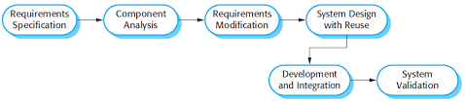
Reuse- Oriented Software Engineering

Slide 63
Types of reusable software
Standalone applications
Packages
Web services

Slide 64
Advantages and disadvantages
Reduced costs and risks as less software is developed from scratch
Faster delivery and deployment of system
requirements compromises are inevitable so system may not meet real needs of users
Loss of control over evolution of reused system elements

Slide 65
Coping with change
Change is inevitable in all large software projects.
Business changes lead to new and changed system requirements
New technologies open up new possibilities for improving Implementations
Changing platforms require application changes
Change leads to rework so the costs of change include both rework as well as the costs of implementing new functionality

Slide 66
Reducing the costs of rework-2 ways of handling changes
Change anticipation-avoid by using prototype
Change tolerance-to accommodate changes use incremental development

Slide 67
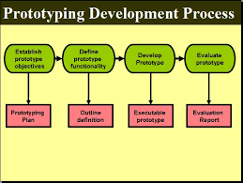
The process of prototype development

Slide 68
Types of prototype
Sketches and diagrams , wireframes
Functional
3D modelling
Miniature
Prototyping is a foundational process for developing a new product through the physical representation of an idea.

Slide 69
Throw-away prototypes
Prototypes should be discarded after development as they are not a good basis for a production system
It may be impossible to tune the system to meet non-functional requirements
Prototypes are normally undocumented;

Slide 70
Advantages of Throw Away Prototyping
Save time and money
Promote consistency of user interface design
Enable early customer engagement

Slide 71
DisAdvantages of Throw Away Prototyping
There is no clear stop point
Normally it does not generate reusable code
Excessive development time of the prototype

Slide 72
Evolutionary prototyping
It’s useful for exploratory programming, such as Artificial Intelligence applications, where it is difficult to frame specifications.
This model is very suitable for research projects. For example, in order to develop software for automatic speech recognition, it is possible to take a small vocabulary and develop a system.

Slide 73
Disadvantages of Evolutionary Development Model
As the project is open-ended, no time frame is able to be set.
It is difficult to monitor the project.
The visibility is low compared to the waterfall model.

Slide 74
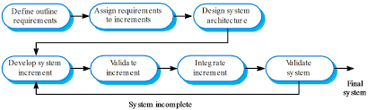
Incremental delivery

Slide 75
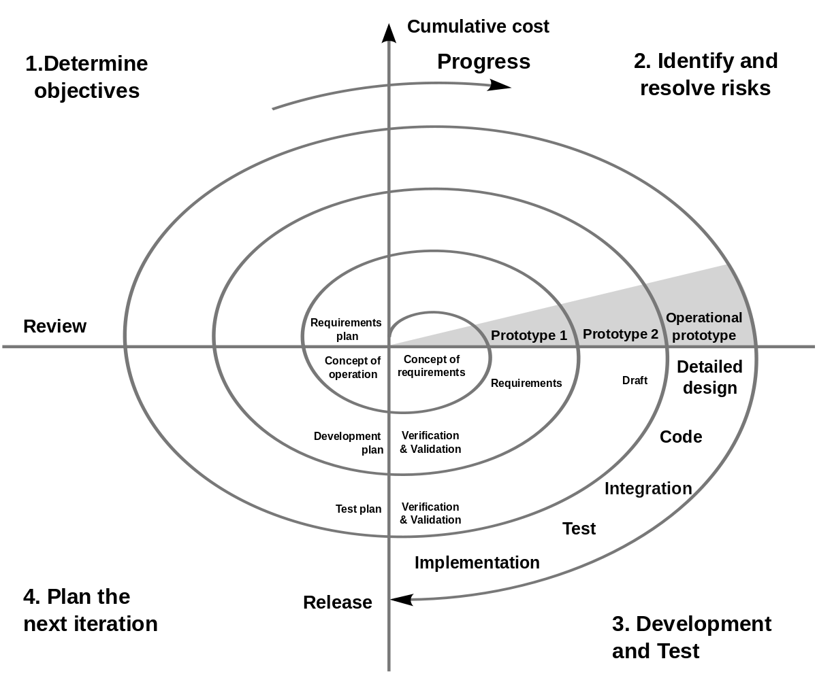
Boehm’s Spiral model

Slide 76
A typical cycle of the spiral:Quadrant 1
the objectives of the portion of the product being elaborated (performance, functionality, ability to accommodate change, etc.);
the alternative means of implementing this portion of the product (design A , design B, reuse, buy, sub contract etc.); and
• the constraints imposed on the application of the alternatives (cost, schedule, inter-face, etc.).

Slide 77
Quadrant 2
Study alternatives: relative to objective and constraints
Identify risks( lack of experience, new technology, tight schedules, poor process, etc)
Resolve risks(handling development method)

Slide 78
Quadrant 3
Create a design
Review design
Develop code
Inspect code
Test product

Slide 79
Quadrant 4
Develop a project plan
Develop configuration management plan
Develop a test plan
Develop a installation plan

Slide 80
Boehm’s spiral model
Combination of iterative and waterfall development
High emphasis on risk analysis
software process is represented as a spiral, rather than a sequence of activities
Each loop in the spiral represents a phase of the software process.
innermost loop might be concerned with system feasibility, the next loop with requirements definition, the next loop with system design,

Slide 81
Boehm’s spiral model applications
When project is large.
When releases are required to be frequent.
When creation of a prototype is applicable.
When risk and costs evaluation is important.
For medium to high-risk projects.
When requirements are unclear and complex.
When changes may require at any time.

Slide 82
Process improvement
way of enhancing the quality of their software, reducing costs or accelerating their development processes.
Process improvement means understanding existing processes and changing these processes to increase product quality and/or reduce costs and development time.

Slide 83
Process improvement activities
Process measurement
Process analysis-process maps are developed
Process change

Slide 84
Process metrics
Time taken for process activities to be completed
Resources required for processes or activities
Number of occurrences of a particular event

Slide 85
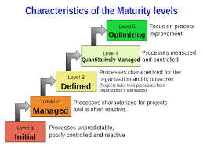
Capability maturity levels

Slide 86
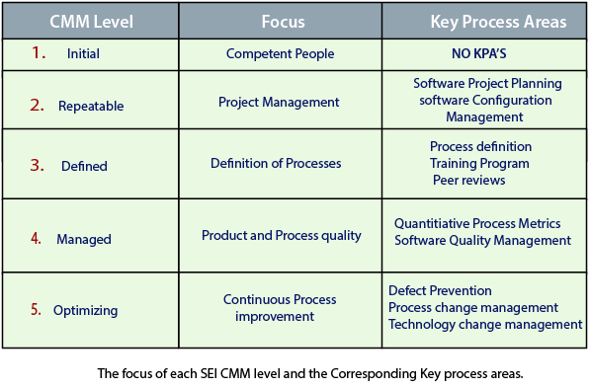

Slide 87
The Rational Unified Process
Derived from work on UML
Created by Rational Software Corporation
RUP is normally described from three perspectives
A dynamic perspective, which shows the phases of the model over time.
A static perspective, which shows the process activities that are enacted.
A practice perspective, which suggests good practices to be used during the process

Slide 88
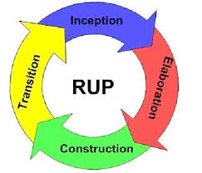
The Rational Unified Process

Slide 89
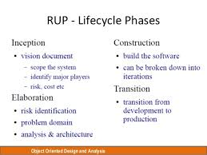
The Rational Unified Process

Slide 90
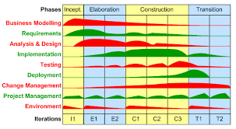
workflows

Slide 91
Best practices of RUP
Develop software iteratively
Manage requirements
Use component-based architectures
Visually model software
Verify software quality
Control changes to software

Slide 92
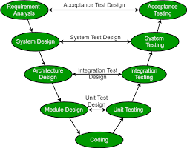
V-model

Slide 93
Agile Software Development
Introduction to agile methods
Agile development techniques
Agile project management
Scaling agile methods.

Slide 94
Rapid software development
Rapid development and delivery is now often the most important requirement for software systems.
Businesses operate in a fast –changing requirement and it is practically impossible to produce a set of stable software requirements.
Software has to evolve quickly to reflect changing business needs
Specification, design and implementation are inter-leaved
System is developed as a series of versions with stakeholders involved in version evaluation.
User interfaces are often developed using an IDE and graphical toolset.

Slide 95
Rapid software development
Focus on the code rather than the design
Are based on an iterative approach to software development
Are intended to deliver working software quickly and evolve this quickly to meet changing requirements.
The aim of agile methods is to reduce overheads in the software process (e.g. by limiting documentation) and to be able to respond quickly to changing requirements without excessive rework.

Slide 96
Rapid software development
Individuals and interactions over processes and tools
Working software over comprehensive documentation
Customer collaboration over contract negotiation
Responding to change over following a plan

Slide 97
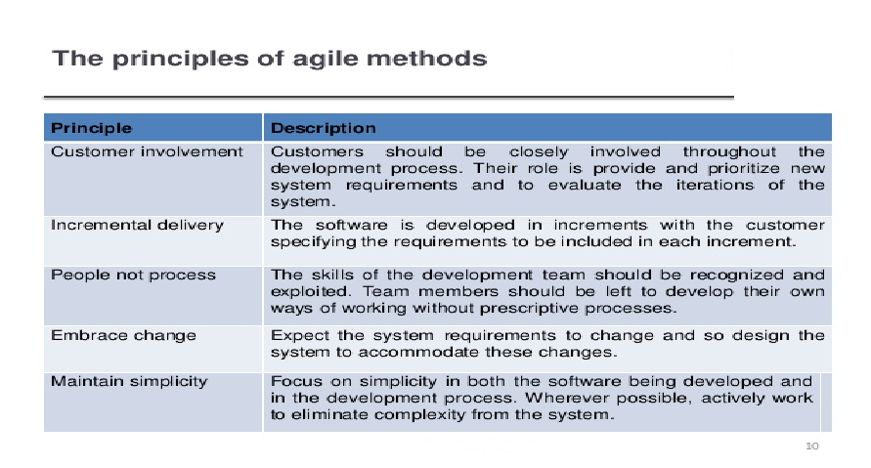
Agile Methodology

Slide 98
Agile method applicability
Product development where a software company is developing a small or medium-sized product for sale.
Custom system development within an organization, where there is a clear commitment from the customer to become involved in the development process and where there are not a lot of external rules and regulations that affect the software.
Because of their focus on small, tightly-integrated teams, there are problems in scaling agile methods to large systems.

Slide 99
Problems with agile methods
It can be difficult to keep the interest of customers who are involved in the process.
Team members may be unsuited to the intense involvement that characterizes agile methods.
Prioritizing changes can be difficult where there are multiple stakeholders.
Maintaining simplicity requires extra work
Contracts may be a problem as with other approaches to iterative development

Slide 100
Agile methods and software maintenance
If agile methods are to be successful, they have to support maintenance as well as original development.
Two key issues:
Are systems that are developed using an agile approach maintainable, given the emphasis in the development process of minimizing formal documentation?
Can agile methods be used effectively for evolving a system in response to customer change requests?
Problems may arise if original development team cannot be maintained.

Slide 101
Technical, human, organizational issues
Most projects include elements of plan-driven and agile processes. Deciding on the balance depends on:
Is it important to have a very detailed specification and design before moving to implementation? If so, you probably need to use a plan-driven approach.
Is an incremental delivery strategy, where you deliver the software to customers and get rapid feedback from them, realistic? If so, consider using agile methods.

Slide 102
Technical, human, organizational issues
How large is the system that is being developed? Agile methods are most effective when the system can be developed with a small co-located team who can communicate informally. This may not be possible for large systems that require larger development teams so a plan-driven approach may have to be used.
What type of system is being developed?
Plan-driven approaches may be required for systems that require a lot of analysis before implementation

Slide 103
Technical, human, organizational issues
What is the expected system lifetime?
Long-lifetime systems may require more design documentation to communicate the original intentions of the system developers to the support team.
What technologies are available to support system development?
Agile methods rely on good tools to keep track of an evolving design
How is the development team organized?
If the development team is distributed or if part of the development is being outsourced, then you may need to develop design documents to communicate across the development teams

Slide 104
Technical, human, organizational issues
Are there cultural or organizational issues that may affect the system development?
Traditional engineering organizations have a culture of plan-based development, as this is the norm in engineering.
How good are the designers and programmers in the development team?
Is the system subject to external regulation?

Slide 105
Extreme programming
Extreme Programming (XP) takes an ‘extreme’ approach to iterative development.
New versions may be built several times per day;
Increments are delivered to customers every 2 weeks;
All tests must be run for every build and the build is only accepted if tests run successfully.

Slide 106
XP and agile principles
Incremental development is supported through small,frequent system releases.
Customer involvement means full-time customer engagement with the team.
People not process through pair programming, collective ownership and a process that avoids long working hours.
Change supported through regular system releases.
Maintaining simplicity through constant refactoring of code.

Slide 107
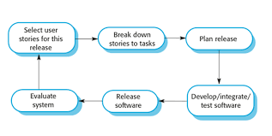
Extreme programming

Slide 108
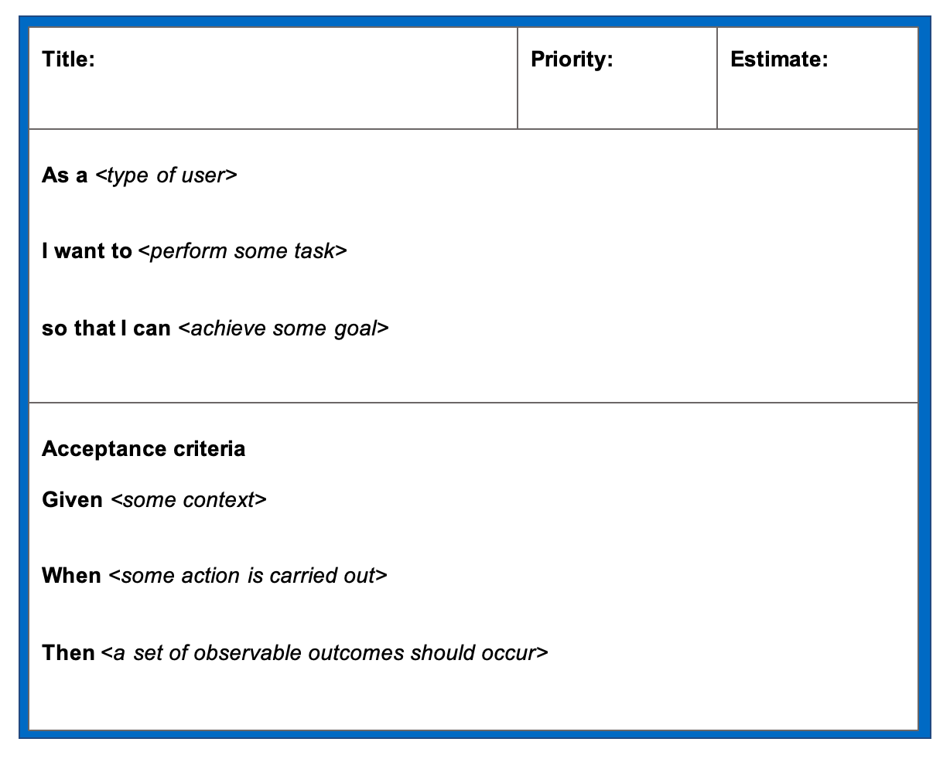
User stories

Slide 109
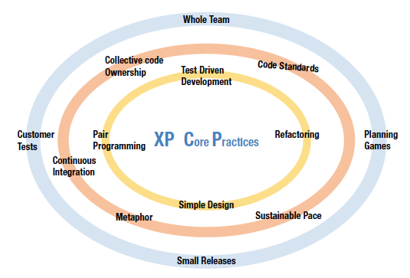
Extreme programming practices

Slide 110
Xp case study
This ten-person team develops a scriptable GUI environment for external customers to develop customized end user and business software.

Slide 111
XP and change
Conventional wisdom in software engineering is to design for change. It is worth spending time and effort anticipating changes as this reduces costs later in the life cycle.
XP, however, maintains that this is not worthwhile as changes cannot be reliably anticipated.
Rather, it proposes constant code improvement (refactoring) to make changes easier when they have to be implemented.

Slide 112
Refactoring
Programming team look for possible software improvements and make these improvements even where there is no immediate need for them.
This improves the understandability of the software and so reduces the need for documentation.
Changes are easier to make because the code is well structured and clear.
However, some changes requires architecture refactoring and this is much more expensive.

Slide 113
Testing in XP
XP testing features:
Test-first development.
Incremental test development from scenarios.
User involvement in test development and validation.
Automated test harnesses are used to run all component tests each time that a new release is built.

Slide 114
Test-first development
Writing tests before code clarifies the requirements to be implemented.
Tests are written as programs rather than data so that they can be executed automatically. The test includes a check that it has executed correctly.
All previous and new tests are run automatically when new functionality is added, thus checking that the new functionality has not introduced errors

Slide 115
Customer involvement
The role of the customer in the testing process is to help develop acceptance tests for the stories that are to be implemented in the next release of the system.
The customer who is part of the team writes tests as development proceeds. All new code is therefore validated to ensure that it is what the customer needs.
However, people adopting the customer role have limited time available and so cannot work full-time with the development team. They may feel that providing the requirements was enough of a contribution and so may be reluctant to get involved in the testing process.

Slide 116
XP testing difficulties
Writing incomplete tests
Difficulty in writing test cases
Checking completeness of the tests

Slide 117
Pair programming
In XP, programmers work in pairs, sitting together to develop code.
This helps develop common ownership of code and spreads knowledge across the team.
It serves as an informal review process as each line of code is looked at by more than 1 person.
It encourages refactoring as the whole team can benefit from this.
Measurements suggest that development productivity with pair programming is similar to that of two people working independently

Slide 118
Scrum
The Scrum approach is a general agile method but its focus is on managing iterative development rather than specific agile practices.
There are three phases in Scrum.
The initial phase is an outline planning phase where you establish the general objectives for the project and design the software architecture.
This is followed by a series of sprint cycles, where each cycle develops an increment of the system.
The project closure phase wraps up the project, completes required documentation such as system help frames and user manuals and assesses the lessons learned from the project.

Slide 119
Scrum roles
Product owner
Scrum master
Developers
Scrum is where the team comes together to move the product forward.

Slide 120
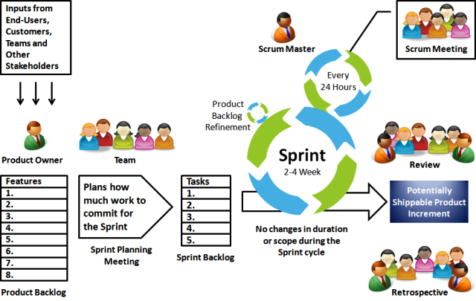
The Scrum process

Slide 121
The Sprint cycle
Sprints are fixed length, normally 2–4 weeks. They correspond to the development of a release of the system in XP.
The starting point for planning is the product backlog, which is the list of work to be done on the project.
The selection phase involves all of the project team who work with the customer to select the features and functionality to be developed during the sprint.

Slide 122
The Sprint cycle
Once these are agreed, the team organize themselves to develop the software.During this stage the team is isolated from the customer and the organization, with all communications channeled through the so-called ‘Scrum master’.
The role of the Scrum master is to protect the development team from external distractions.
At the end of the sprint, the work done is reviewed and presented to stakeholders. The next sprint cycle then begins.

Slide 123
Teamwork in Scrum
The ‘Scrum master’ is a facilitator who arranges daily meetings, tracks the backlog of work to be done, records decisions, measures progress against the backlog and communicates with customers and management outside of the team.
The whole team attends short daily meetings where all team members share information, describe their progress since the last meeting, problems that have arisen and what is planned for the following day.
This means that everyone on the team knows what is going on and, if problems arise, can re-plan short-term work to cope with them.

Slide 124
Scrum benefits
The product is broken down into a set of manageable and understandable chunks.
Unstable requirements do not hold up progress.
The whole team have visibility of everything and consequently team communication is improved.
Customers see on-time delivery of increments and gain feedback on how the product works.
Trust between customers and developers is established and a positive culture is created in which everyone expects the project to succeed.

Slide 125
Scrum example
X is assigned as the Scrum Product Owner of a new software development project.
One of the first tasks of X is to start requirement engineering. X writes down the most important use-cases and discusses them with the architects, customer representatives and other stakeholders.
After collecting the high-level use-cases and requirements, X writes them into the Scrum Product Backlog and initiates an estimation and prioritization session with the architects and some senior developers.

Slide 126
Scrum example
As a result of this session all the items in the Scrum Product Backlog have an initial rough estimation and a prioritization.
Now X starts to break-down the high-level requirements into smaller-grained user stories. With this list X then calls for the first Sprint Planning meeting.

Slide 127
Sprint 1 - Day 0
During the Sprint Planning meeting X presents the Scrum Product Backlog items from the highest priority to the lowest.
The team clarifies open questions and for each item the team discusses if they have enough capacity, the required know-how and if everything else needed is available.
After this discussion they commit to complete the stories 1,2,3,6,7 and 8 until the end of this sprint. The items 4 and 5 cannot be realized in this sprint, as some technical infrastructure is not yet in place.

Slide 128
User stories
A user story is an informal, general explanation of a software feature written from the perspective of the end user. Its purpose is to articulate how a software feature will provide value to the customer.
User stories describe the why and the what behind the day-to-day work of development team members

Slide 129
Format of user story
As a < user >
I want to < perform an action >
So that < I expect…. >

Slide 130
Example of a user story
<User> - is the end-user or the role of the user in the application software – “As a net banking customer”
<perform an action> - the action the user is performing on the application software – “I want to add beneficiary in my account”
<I expect..> - outcome, desired value, the user expects out of the action performed – “so that I can transfer money to the added beneficiary”

Slide 131
User stories
The larger-sized stories are called “Epics” which are then decomposed to “Features” and then further decomposed to a “User Story”
Epic example: As a Bank, I want to provide net banking to customers, so that they can perform various transactions.

Slide 132
User story
Epic example: As a Bank, I want to provide net banking to customers, so that they can perform various transactions.
The above Epic can then be decomposed into multiple features:
As a Bank, I want to provide a funds transfer feature to customers, so that they can transfer funds from one account to another account
As a Bank, I want to provide an account summary for all the customer’s types of accounts.
As a Bank, I want to provide credit card details to customers.
Now each feature can be decomposed further into multiple user stories.

Slide 133
Sprint 1 - Day 0
After the Sprint Planning meeting the Scrum Master of the team - calls the team to define the details of how the committed items are going to be implemented.
The resulting tasks are written down on the cards at the prepared Sprint Task board. Now everyone of the Scrum Team selects a task to work on.

Slide 134
Sprint 1 - Day 1
In the morning the whole team gets together for their Daily Scrum Meeting. Everyone gives a short statement what has been achieved so far, one of the team members tells that he has problems because he needs a new license for one of the software tools he is using, the scrum master checks the issue if exists with anyone else in the team and solves it.

Slide 135
Sprint 1 - Day 2
In the morning again the whole team gets together for their Daily Scrum meeting. In the afternoon one of the Scrum team members is unsure about the details of one of the user stories.

Slide 136
Sprint 1 - Day 21
This is the final day of the first Sprint and Scrum Master- has invited the team for the Sprint Review Meeting.
The team has prepared a machine with the current software implementation.
Scrum Product Owner- sits in front of the machine and checks if the implementation meets his expectations and if the features are documented as required. At the end of the Review Session he concludes:
Stories 1,2,6 and 7 are finished as expected.
Story 3 couldn't be finished in time and was not presented at all.
Story 8 has some points that have to be re-factoring.

Slide 137
Example of Epic,Feature,User Story
ID | EPICS
E1 | As a Banking Customer, I want to access net banking, so that I can access my account and make transactions
E2 | As a Sales Professional, I want to generate reports so that I can take a decision on the marketing strategy for the upcoming quarter
E3 | As an Administrator of the software, I want to access master records so that I can make changes to customer data

Slide 138
Features
ID | Feature
E1F1 | As a Banking Customer, I want to access Savings account so that I can view/make transactions
E1F2 | As a Banking Customer, I want to access Credit Card page, so that I can view and make transactions
E1F3 | As a Banking Customer, I want to access Loans page so that I can view my loans
E1F4 | As a Banking Customer, I want to transfer funds, so that I can move my funds to different accounts within my bank and other banks

Slide 139
User story
ID | User story
E1F1U1 | As a Banking Customer, I want to access/view summary of my savings account, so that I know my balance and other details
E1F2U2 | As a Banking Customer, I want to Login to Net banking so that I can view credit card details
E1F4U3 | As a Banking Customer, I want to transfer funds from my account to another account in another bank, so that I can send money to my family and friends who have accounts in other banks
E1F4U4 | As a Banking Customer, I want to transfer funds within my own accounts so that I can move some balance across my accounts
E1F4U5 | As a Banking Customer, I want to add beneficiary to my account, so that I can transfer funds to the beneficiary

Slide 140
Scaling agile methods
Agile methods have proved to be successful for small and medium sized projects that can be developed by a small co-located team.
It is sometimes argued that the success of these methods comes because of improved communications which is possible when everyone is working together.
Scaling up agile methods involves changing these to cope with larger, longer projects where there are multiple development teams, perhaps working in different locations.

Slide 141
Large systems development
Large systems are usually collections of separate, communicating systems, where separate teams develop each system. Frequently, these teams are working in different places, sometimes in different time zones.
Large systems are ‘brownfield systems’, that is they include and interact with a number of existing systems. Many of the system requirements are concerned with this interaction and so don’t really lend themselves to flexibility and incremental development.
Where several systems are integrated to create a system, a significant fraction of the development is concerned with system configuration rather than original code development.

Slide 142
Large systems development
Large systems and their development processes are often constrained by external rules and regulations limiting the way that they can be developed.
Large systems have a long procurement and development time. It is difficult to maintain coherent teams who know about the system over that period as, inevitably, people move on to other jobs and projects.
Large systems usually have a diverse set of stakeholders.It is practically impossible to involve all of these different stakeholders in the development process.

Slide 143
Scaling out and scaling up
‘Scaling up’ is concerned with using agile methods for developing large software systems that cannot be developed by a small team.
‘Scaling out’ is concerned with how agile methods can be introduced across a large organization with many years of software development experience.
When scaling agile methods it is essential to maintain agile fundamentals
Flexible planning, frequent system releases, continuous integration, test-driven development and good team communications.

Slide 144
Scaling out and scaling up
For large systems development, it is not possible to focus only on the code of the system. You need to do more up-front design and system documentation
Cross-team communication mechanisms have to be designed and used. This should involve regular phone and video conferences between team members and frequent, short electronic meetings where teams update each other on progress.
Continuous integration, where the whole system is built every time any developer checks in a change, is practically impossible. However, it is essential to maintain frequent system builds and regular releases of the system

Slide 145
Scaling out to large companies
Project managers who do not have experience of agile methods may be reluctant to accept the risk of a new approach.
Large organizations often have quality procedures and standards that all projects are expected to follow and, because of their bureaucratic nature, these are likely to be incompatible with agile methods.
Agile methods seem to work best when team members have a relatively high skill level. However, within large organizations, there are likely to be a wide range of skills and abilities.
There may be cultural resistance to agile methods, especially in those organizations that have a long history of using conventional systems engineering processes.

